Slide 1
Making a Career in Data Science
Michael Becker
Senior Data Scientist @ Penn Medicine
#DataJawn
@beckerfuffle
Notes:
one of the most common questions I get is on how to get into data science. So I figured it’s about time I gave a talk on the subject. So here’s my talk on making a career in data science.

Slide 2
So you want to be a Data Scientist?
#DataJawn
@beckerfuffle
Notes:
Or so you want to be a Data Scientist?

Slide 3
What’s in a Job Title?
Get Educated
Data Science Skills
The Portfolio
The Job Search
Finding a Good Employer
Practice Makes Perfect
Story Time!
#DataJawn
@beckerfuffle

Slide 4
bit.ly/SurveyJawn
#DataJawn
@beckerfuffle
Notes:
Much of the data presented today is based on a survey I setup specifically for this talk. I ended up with around 150 responses. If you haven’t already filled out the survey you can do so at bit.ly/SurveyJawn. I’ll be writing the results in more detail on my blog.

Slide 5

TITLES
#DataJawn
@beckerfuffle

Slide 6
#DataJawn
@beckerfuffle
Notes:
About 2/3 of respondents are not Data Scientists. But as Vicki Boykis has pointed out, it’s often easier to come into a data science job through the back door. Vicki started off as an Analyst. I used to be a Software Engineer. In my experience almost no one takes a direct path to a Data Science role. So maybe consider an alternative path?

Slide 7
Alternate Roles
Data Analyst
Data Engineer
Machine Learning Engineer
#DataJawn
@beckerfuffle
Notes:
Analysts focus on developing insights from data. There are 3x more openings for Analysts than for Data Scientists.
Data Engineers focus on collecting data into a useable form for Analysts and Data Scientists. There are 10x more Data Engineer openings than Data Scientist openings.
ML Engineers focus on deploying models and optimizing them for production.

Slide 8

Education
By Saad Andalib; CC BY 2.0, flickr.com/photos/saadandalib/8536426163
#DataJawn
@beckerfuffle
Notes:
what kind of education do you need to be a data scientist?

Slide 9
#DataJawn
@beckerfuffle
Notes:
Data Scientists are less likely to have a Bachelors and more likely to have a PhD. I assume this is at least partly because many openings list a Masters or PhD as a requirement. It’s probably also self selection. A common theme is someone goes to college for a Physics or other PhD and makes a move to industry because of the competition for tenure track positions. This doesn’t mean you need a PhD to be a Data Scientist but it does mean that you’ll need to work harder to make yourself stand out.

Slide 10
#DataJawn
@beckerfuffle
Notes:
Looking at degrees we see that the majority of Data Scientists have a Math or Science degree. How much of this is self selection vs other factors like bias in the hiring process is hard to say. If you have a degree that didn’t focus on Science or Math it certainly can’t hurt to go back to school and get a degree that more focused on Data Science.

Slide 11
#DataJawn
@beckerfuffle
Notes:
Interestingly or not we see that Data Scientists attribute their college degrees towards helping them prepare for a career in Data Science a lot more than aspiring Data Scientists. Would going back to college be helpful for getting a job in Data Science? It’s hard to say but it probably can’t hurt! Bootcamps on the other hand don’t seem to have any real impact. Maybe they’re still too new for us to measure their impact? Or maybe they’re just a fad?

Slide 12
#DataJawn
@beckerfuffle
Notes:
When asked if they could go back in time and focus more time on a particular subject the majority of respondents said they would like to have spent more time on Math skills.

Slide 13

Skills
By I, Luc Viatour, CC BY-SA 3.0, commons.wikimedia.org/w/index.php?curid=4632541
#DataJawn
@beckerfuffle
Notes:
what kinds of skills are useful to a data scientist?

Slide 14
#DataJawn
@beckerfuffle
Notes:
When asked what kinds of tools they use on a daily basis data scientists overwhelmingly use Python. SQL comes in a close second beating out R. Focusing on these top tools will help ensure you’re prepared for a job in Data Science.

Slide 15
#DataJawn
@beckerfuffle
Notes:
I feel like this chart is trying to tell me something about my survey design abilities. We can see that the vast majority of respondents spend less than 1/4 of their time building models. As a Data Scientist, you should be prepared to spend most of your time doing data manipulation and analysis. If you’re hoping to get into Data Science so that you can build models all day, you’re better off looking for a career as a ML Research Scientist which means you will almost certainly need a PhD with a thesis on Deep Learning. If Data Scientists are unicorns Research Scientists are Uber Unicorns. I’ve known researchers who have sought out these roles at big companies and even for qualified candidates it’s hard to achieve.

Slide 16
#DataJawn
@beckerfuffle
Notes:
Speaking of Deep Learning, it’s still not very popular in industry. While it’s useful to have some Deep Learning knowledge to make yourself standout in the crowd, you probably won’t be using it on the job. If you’re looking for a job applying Deep Learning you should probably consider a research position. There are still very few applications where it really makes sense to use Deep Learning. Simple models often get the job done!

Slide 17
PORTFOLIO
© Tom White, drib.net
#DataJawn
@beckerfuffle
Notes:
Alright next I’d like to touch briefly on the importance of having a good portfolio of work. A portfolio will help you stand out from other candidates.

Slide 18
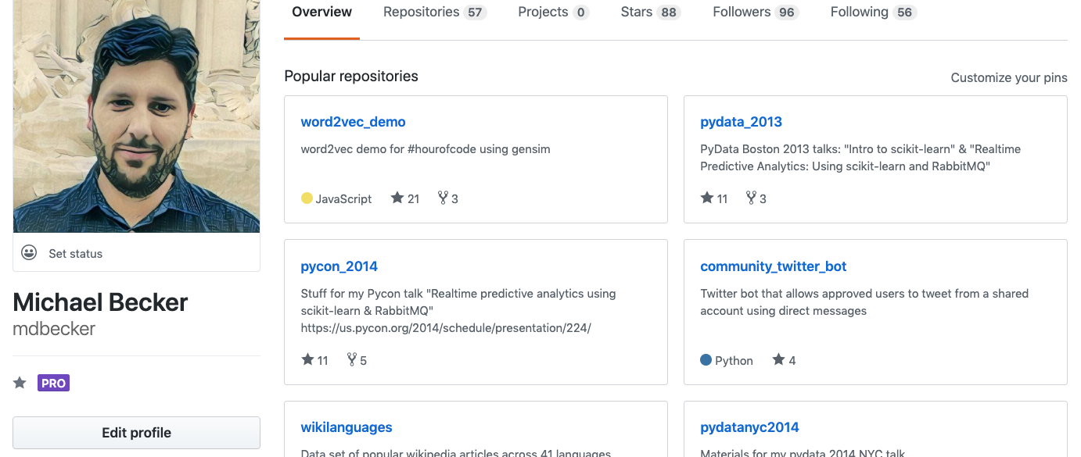
Put everything on GITHUB
#DataJawn
@beckerfuffle
Notes:
Github is an important part of any Data Scientist’s portfolio. Put all your code up on GitHub no matter how crappy you think it is. Having code up on GitHub will give you a leg up on all the candidates with nothing.

Slide 19
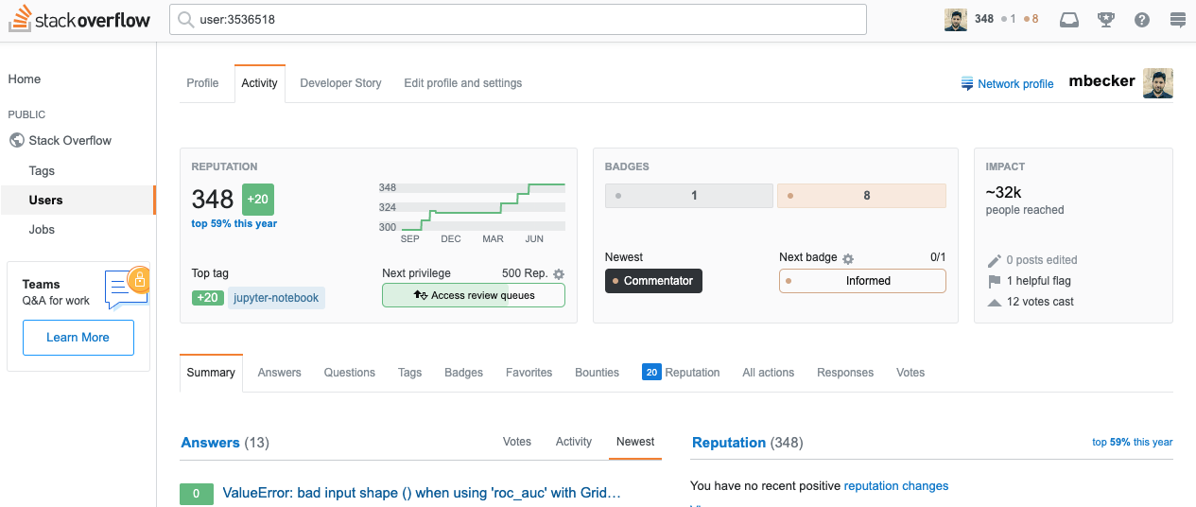
Post on Stackoverflow
#DataJawn
@beckerfuffle
Notes:
Having a stackoverflow account where you’ve answered or even asked questions is a great way to make yourself standout to employers. It shows you have both interest and knowledge in the field.

Slide 20
Personal Projects
#DataJawn
@beckerfuffle
Notes:
Set aside some time to work on personal projects. My favorite project is one where I built a personalized sci-fi book recommender system to help me find new books to read. Which reminds me one of these days I should really put that up on my GitHub!

Slide 21
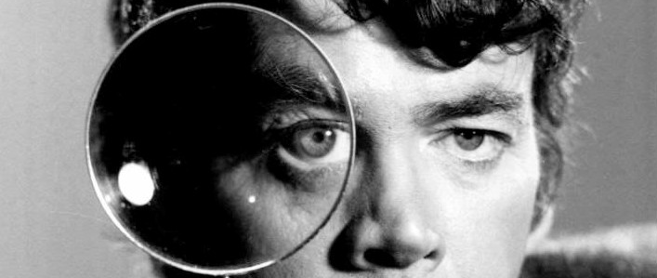
Job Search
#DataJawn
@beckerfuffle
Notes:
Alright let’s talk about things that might help you during the job search process.

Slide 22
#DataJawn
@beckerfuffle
Notes:
The biggest industry hiring data scientists in Philly seems to be the medical/healthcare industry. This isn’t too surprising, our area is well known for both healthcare and pharmaceutical companies. These companies could be a good place to start looking.

Slide 23
#DataJawn
@beckerfuffle
Notes:
Most Data Scientists work in the city with some also in the suburbs. If you live in the suburbs be prepared to commute into center city.

Slide 24
#DataJawn
@beckerfuffle
Notes:
When asked where they got their first Data Science job, the majority of respondents said it was at a large company. Large companies tend to have more mature Data Science strategies and bigger budgets so this isn’t too surprising.

Slide 25
“if you apply for a technical job through Indeed, you’re very unlikely to get anywhere"
–Edouard Harris
#DataJawn
@beckerfuffle
Notes:
Everybody knows Indeed, and it’s easy to apply that way. That means the average person who applies to a job on Indeed is, most likely, an average person.

Slide 26
"start with LinkedIn"
–Jeff Hale
#DataJawn
@beckerfuffle
Notes:
it consistently has the most results

Slide 27
"I look on LinkedIn and find if there is anyone in my network that can recommend me"
–Schaun Wheeler
#DataJawn
@beckerfuffle
Notes:
Networking is a much better way to get an interview than applying online. Not only can you learn more about the opening and the work environment but you’re more likely to be taken seriously. Nepotism at it’s best.

Slide 28
"start embedding yourself in engineer-driven machine learning meetups"
–Edouard Harris
#DataJawn
@beckerfuffle
Notes:
the best engineering teams hire through networks and back channels instead of job boards. Check out DataPhilly!

Slide 29
"If you meet 50% of the requirements, that might be enough. If you meet 70%, you’re good to go. If you meet 100%, there’s a good chance you’re overqualified."
–Jeremie Harris
#DataJawn
@beckerfuffle
Notes:
Don’t worry too much about the job “requirements.” My current job said that it required a Masters/PhD and look at me now!

Slide 30
RED FLAGS
#DataJawn
@beckerfuffle
Notes:
Let’s talk about some things to look out for as potential red flags

Slide 31
"oddly non-specific posting"
–Jeremie Harris
#DataJawn
@beckerfuffle
Notes:
" either because the early stage of their data science effort forces everyone to be a jack of all trades, or because they lack the expertise they need to even know what problems they have, and who can help solve them"

Slide 32
“a PhD is a decent proxy for skill, if you’re not sure what actual skill looks like.”
–Jeremie Harris
#DataJawn
@beckerfuffle
Notes:
“AI-savvy companies have enough experience with talent discovery that they don’t need to use formal education, or years of experience, as a proxy for skill.”

Slide 33
PRACTICE
#DataJawn
@beckerfuffle
Notes:
Let’s talk briefly about what you can do to help prepare for Data Science job interviews

Slide 34
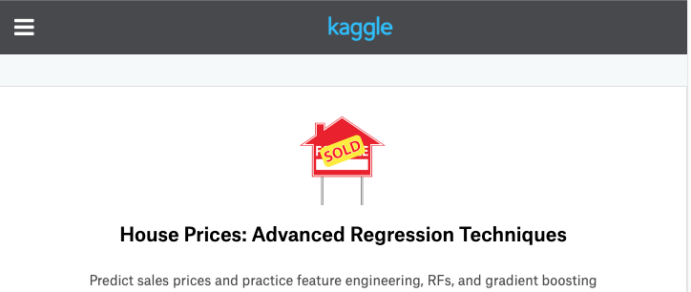
Kaggle
#DataJawn
@beckerfuffle
Notes:
Lots of companies will give you either in person or take home data challenges as part of the hiring process. Kaggle can be good practice for these types of interviews.

Slide 35
Personal Projects
#DataJawn
@beckerfuffle
Notes:
And of course personal projects are a great way to keep your skills fresh.

Slide 36
Story Time!
#DataJawn
@beckerfuffle
Notes:
All right now let’s look at what some of our survey respondents said about the paths they took to becoming data scientists

Slide 37
“I got my PhD in Physics in 2018, took ~9 months of networking and interviewing before getting two offers”
#DataJawn
@beckerfuffle
Notes:
This is a pretty typical path. There’s lots of Physics PhD’s but few tenure track positions. Statistics and modeling are common place in Physics research so these skills are easily transferable to Data Science roles.

Slide 38
“I started out more or less as a data analyst, at a company that also had a large data science team. After about 8 months I was able to transition into an entry-level DS role on a team closely related to my analyst work”
#DataJawn
@beckerfuffle
Notes:
Again this is a really common experience. When I first met Vicki Boykis she was a Data Analyst at Comcast. You might have to skill up on the job but this is a really good way to transition to a Data Science role.

Slide 39
“Started as a Data Engineer, did Science-y projects in my spare time, transitioned internally through an established program.”
#DataJawn
@beckerfuffle
Notes:
This closely mirrors my own personal experience going from a Software Engineer to a Data Science role.

Slide 40
“I was an epidemiologist and got frustrated at how much data is collected by the government and how little bandwidth they give analysts to be creative with it so I moved into the private industry and figured out how to use my stats background to do that work.”
#DataJawn
@beckerfuffle
Notes:
Having a background in stats is definitely useful in making the transition into Data Science.

Slide 41
“started as a data analyst right after undergrad. It wasn't fulfilling and my career prospects were limited so I went back to school to get my master's in information and data science”
#DataJawn
@beckerfuffle
Notes:
Going back to school can definitely be a good way to transition to Data Science. There are many Data Science programs from reputable universities, many of them accelerated.

Slide 42
“I always considered myself an applied social scientist, and I've been doing data science in some form for 25 years. I call myself a data scientist now because people seem to understand what that means a little better. ”
#DataJawn
@beckerfuffle
Notes:
Sometimes becoming a Data Scientist is just as simple as calling yourself a Data Scientist. If the work you’re doing seems to be Data Science work, consider calling it what it is. The official job title will come with time.

Slide 43
bit.ly/SurveyJawn
github.com/mdbecker/datajawn2019
#DataJawn
@beckerfuffle

Slide 44
We’re Hiring!
bit.ly/UPHSData bit.ly/UPHSEngineer
#DataJawn
@beckerfuffle

